Slide 1
User Manual – Investment Promotion Assistance Toolkit
Department of Commerce, Industry and Employment
Government of Madhya Pradesh

Slide 2
TABLE OF CONTENTS
Background context of Post GST Policy
Introducing Key principles of Post-GST Policy solution
Assistance calculator toolkit Instructions

Slide 3
Background context of Post-GST Policy
Department of Commerce, Industry and Employment
Government of Madhya Pradesh

Slide 4
Fiscal incentives available to industries under the erstwhile Industrial Promotion Policy (Pre GST)
VAT & CST Reimbursement* – 5 to10 years
Entry Tax Exemption* – 5 to 7 years
Mandi Fee Exemption for food processing industry
Interest Subsidy for Textile Industry – 5% to 7%
Electricity Duty Exemption – 5 to 10 years for HT connection by a DISCOM
Power Subsidy
Land at reasonable price
*These exemptions shall be replaced by Annual Investment Promotion Assistance for all new units under the Amended Industrial Promotion Policy ,2014 released in Oct’17

Slide 5
Erstwhile Incentives that are subsumed in GST and no longer applicable
VAT & CST Reimbursement*
Entry Tax Exemption*
*These exemptions shall be replaced by Annual Investment Promotion Assistance for all new units under the Amended Industrial Promotion Policy ,2014 released in Oct’17

Slide 6
Proposed Solution to replace extant exemptions
Principle
Considering the difficulties in implementing net realized/ retained tax based incentives (SGST Reimbursement) and importance of incentivizing the companies for a less consuming state like Madhya Pradesh, we delinked fiscal incentives (that are affected by GST implementation) provided to industries from the tax accruals to the State.
Solution –
An Investment Promotion Assistance which is linked to Investment (in Plant & Machinery), in the form of Deferred Payments with specific focus on employment generation and export oriented units

Slide 7
Introducing Key principles of Post-GST Policy solution
Department of Commerce, Industry and Employment
Government of Madhya Pradesh

Slide 8
Key Principles enshrining Investment Promotion Assistance
Key Cornerstones of Post GST Policy
Key Design Principles aligned to Cornerstones
2
Protect Smaller
Investors
Incentivizes
Productivity
Promotes
Exports
Rewards
Employment Generation
Least Disruptive
1
Delinking incentives from taxes and replacing them incentives based on Investment in P&M*
1
2
Understanding the capital sensitivity of smaller investors higher incentive percentage offered to smaller investments
5
3
Discouraging idling capacity through linking incentives with annual production value in monetary terms
3
4
Encouraging export oriented units by offering higher incentives to units exporting their produce
4
5
Encouraging export oriented units by offering higher incentives to units exporting their produce
*P&M- Plant & Machinery excluding land and dwelling units ( for more details refer to amended Industrial Promotion Policy , 2014 released in Oct’17

Slide 9
Introducing the Four Step-Approach to calculate Investment Promotion Assistance
Defining four-step approach
Elaborating the four-step approach
Basic Investment
Assistance Value divided into 7 years
Gross Supply
Value Multiple
Export Multiple
Employment Multiple
Applicable Investment in Plant and Machinery
1
A formula that calculates applicable Investment promotion assistance at a certain value of Investment in P&M*
4
3
2
Applicable assistance calculated in step 1 multiplied to a constant whose value depends on current year production
2
1
3
The value calculated in step 2, multiplied to Export Multiple a constant whose value depends on annual % of exports
4
The value calculated in step 2, multiplied to Export Multiple a constant whose value depends on annual employment
Basic Investment Assistance Value – Capped at 150 crores
Gross Supply Value Multiple – varies from 0 to 1
Export Multiple – varies from 1 to 1.2
Employment Multiple – varies from 1 to 1.5
Calculated Yearly Incentive Value
*P&M- Plant & Machinery excluding land and dwelling units ( for more details refer to amended Industrial Promotion Policy , 2014 released in Oct’17

Slide 10
Assistance calculator toolkit Instructions
Department of Commerce, Industry and Employment
Government of Madhya Pradesh

Slide 11
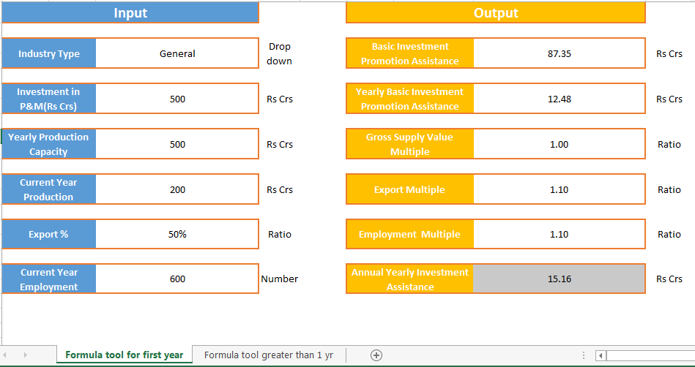
Decoding the Calculator toolkit
INPUT
OUTPUT
1
2
1*
This tab in the tool is for calculation to be done in First year since CoD
2*
This tab in the tool is for calculation to be done from Second year since CoD
*Incentive available for a total period of 7 years and to vary every year based on input values

Slide 12
Decoding output for First year
INPUT
OUTPUT
1
2
3
4
5
6
INPUT DEFINITIONS
1
Input for type of Industry – Select from Drop down(General or Food Processing)
Installed Production capacity values at CoD in Rs Crs
Export proportion value as a percentage of total value of goods (%)
3
5
2
Investment in Plant& Machinery in Rs Crs
Production value in first year since CoD
in Rs Crs
Current Year Employment in Numbers
4
6
*Detailed formulas for the output parameters defined in Section 16 of Amended Industrial Promotion Policy released in Oct’17

Slide 13
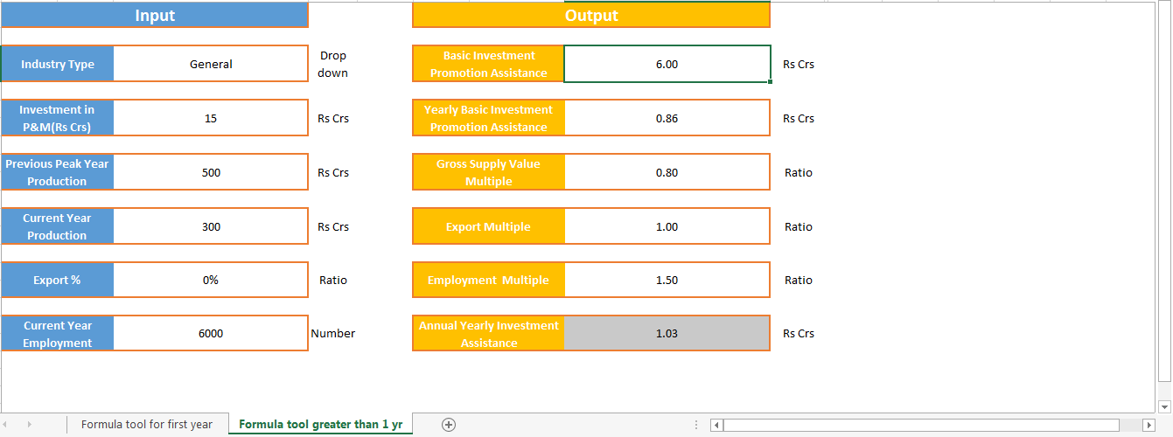
Decoding output Second year onwards
INPUT
OUTPUT
1
2
3
4
5
6
INPUT DEFINITIONS
1
Input for type of Industry – Select from Drop down(General or Food Processing)
Previous Peak Year Production value
since CoD in Rs Crs
Export proportion value as a percentage of total value of goods (%)
3
5
2
Investment in Plant&Machinery in Rs Crs
Production value in current year
in Rs Crs
Current Year Employment in Numbers
4
6
*Detailed formulas for the output parameters defined in Section 16 of Amended Industrial Promotion Policy released in Oct’17

Slide 14
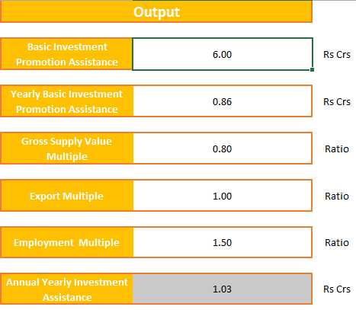
Decoding output parameters
OUTPUT DEFINITION
Defined as BIPA, Section 16.1.1 in Amended Policy
Defined as YBIPA, Section 16.1.1 in Amended Policy
Defined as GSM, Section 16.1.2 in Amended Policy
Defined as EM, Section 16.1.3 in Amended Policy
Defined as EYM, Section 16.1.4 in Amended Policy
Defined as Annual Investment Promotion Assistance, Section 16.1 in Amended Policy
Amended IPP Policy 2014
Click on the pdf link to download amended policy document with all exhaustive details , definitions and formulas
*
*
*Detailed formulas for the output parameters defined in Section 16 of Amended Industrial Promotion Policy released in Oct’17

Slide 15
Thank You.

